Slide 1

ULTRA SONIC BLIND STICK Third Eye
Under the guidance of :
Mr.K.Bhaskar
Assistant Professor, Department of CSE
Submitted by:
V.SRIRAM (16481A05M7)

Slide 2
ABSTRACT
For a visually impaired persons problems get worse when there is an obstacle in front of them .
Our project provide a smart ultrasonic aid for blind people. The system is intended to provide overall measures – Artificial vision and object detection.
Ultrasonic sensors are used to calculate distance of the obstacles around the blind person to guide the user towards the available path.
Similarly moisture sensor and LDR sensors are used to detect liquid on the floor and lights in the room respectively.

Slide 3
OBJECTIVE
The aim of the overall system is to provide a low cost and efficient navigation aid for a visually impaired person who gets a sense of artificial vision by providing information about the environmental scenario of static and dynamic objects around them.
With the help of this project , visually impaired persons can find it easy in detecting various obstacles around them.
The outcome of this project to delivered by sequence of voice sounds which the person can hear.

Slide 4
RELATED WORK
Combining all the components to form a circuit.
Writing code into a microcontroller.
Calibrating the Ultrasonic sensor.
Calibrating the Moisture sensor.
Calibrating the LDR.
Calibrating the RF remote.
Calibrating the audio play back module.
Attaching the circuit to the walking stick.

Slide 5
METHODOLOGY
Project Title:
Ultrasonic smart blind stick
Components used:
1) Arduino Uno
2)Ultrasonic sensor
3)Moisture Sensor
4)LDR sensor
5)Arduino voice playback module
6)Speaker
7)Arduino IDE
8)RF Transmitter and receiver.

Slide 6
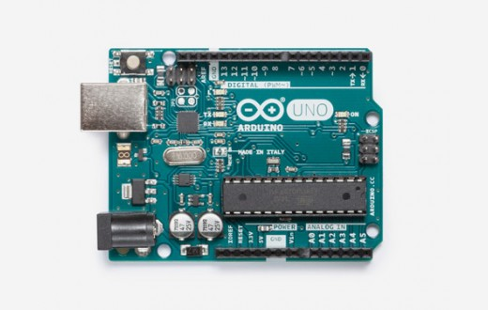
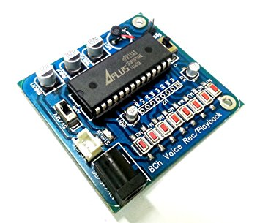
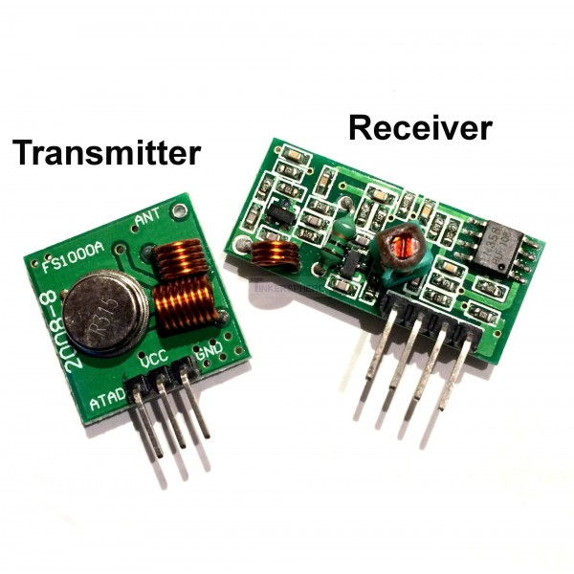
Arduino UNO
The Arduino Uno is a microcontroller board based on the ATmega328 .
APR33Avoice processor
The APR33A series are powerful audio processor along with high performance audio analog-
to-digital converters (ADCs) and digital-to- analog converters (DACs).
RF 433 MHz
An RF module (radio frequency module) is a (usually) small electronic circuit used to
transmit and/or receive radio signals on one of a number of carrier frequencies.

Slide 7
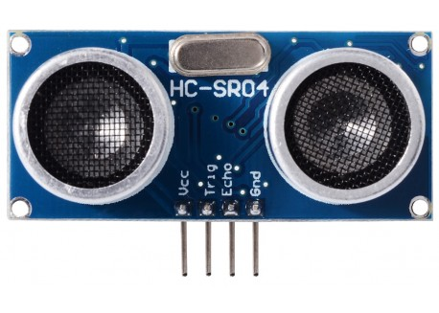
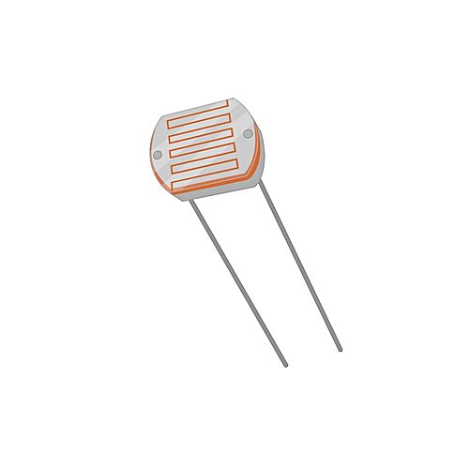
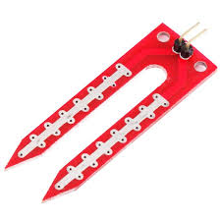
Ultrasonic sensor
An Ultrasonic sensor is a device that can measure the distance to an object by using sound waves. It measures distance by sending out a sound wave at a specific frequency
LDR
An LDR is a component that has a ( variable) resistance that changes with the light intensity that falls upon it.
Moisture sensor
Moisture sensor is used to detect the water or any type of liquids present on the floor.

Slide 8
Assemble and Code at each stage:
First the circuits are connected to one another with the help of jumper wires.
The voices are recorded into the playback module.
The code for the functioning tasks of the sensors is written in Arduino IDE.
The code is compiled. If there are no errors then it uploaded to the Arduino UNO.

Slide 9
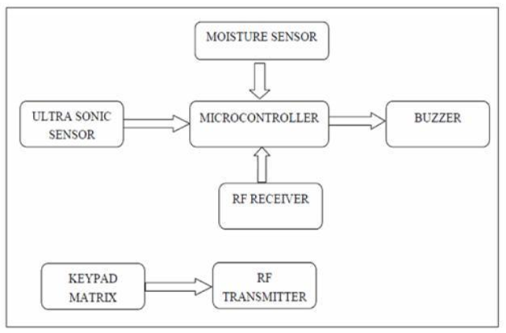
SYSTEM ARCHITECTURE:

Slide 10
Arduino Code Structure:
void setup() {
// put your setup code here, to run once:
}
void loop() {
// put your main code here, to run repeatedly:
}

Slide 11
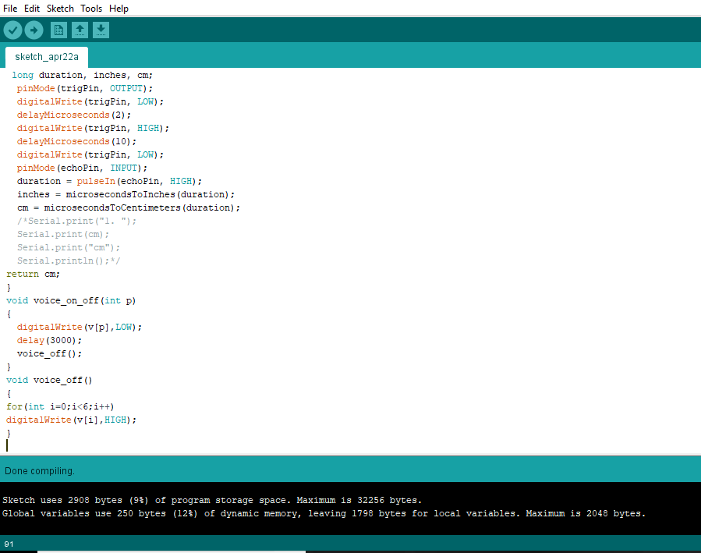

Slide 12
Thank You

